Slide 1
Programming in PHP
Kamal Lama
Sr. Software engineer
Nepware Pvt. Ltd.

Slide 2





Slide 3
1. Programming Setup
Setting up local development environment using WAMP, XAMP, LAMP, MAMP etc.
Document root directory : where all the files are to be stored in order to serve from the web server (eg:- apache, nginx etc.)
Default document root directory for
XAMP :: - c:\xamp\htdocs
WAMP :: c:\wamp\www
LAMP :: /var/www/html/
MAMP :: /Library/WebServer/Documents

Slide 4
PHP Introduction
PHP stands for Hypertext Pre-processor
PHP is one of the widely used open sourced server-side scripting language
Every PHP file needs to have .php extension

Slide 5
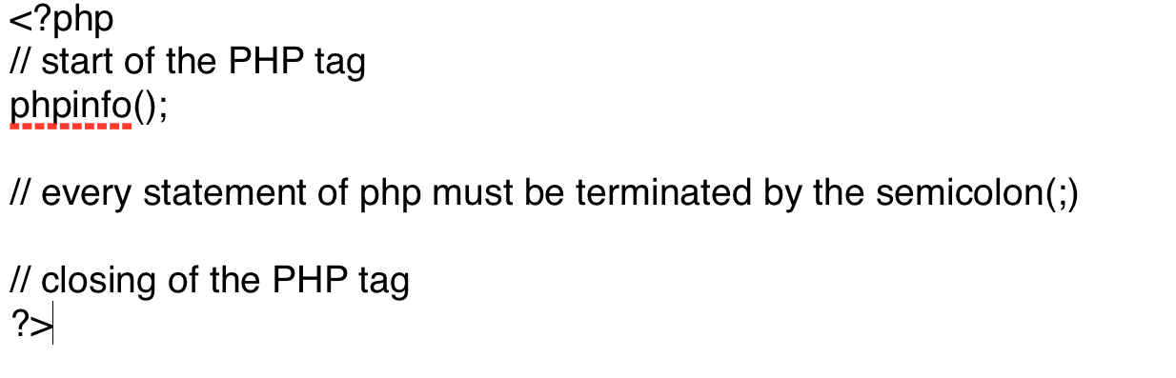
PHP syntax

Slide 6
Variables and display function
In PHP variables are declared with `$` followed by name of the variable
Variables names are case-sensitive (eg: $apple and $APPLE are two different variables ).
echo or echo()
print or print()
var_dump()// dumps information about one or more variable
print_r()

Slide 7
Data Types
PHP supports following data types
String :– sequence of character, like “hello nepal”
Integer :– non-decimal number between -2,147,483,648 to 2,147,483,648
Double(Float) :- number with a decimal point
Boolean :- represents two possible states: TRUE OR FALSE
Array :- stores multiple values in one single variable
Indexed array
Associative array
Multidimensional array
Object :- object is an instance of a class.
Null :- special data type which can have only one value: NULL
Resource: stores a reference to function and resources external to PHP

Slide 8
MySQL
Open Source Relational SQL Database Management System.
SQL stands for Structured Query Language
SQL is a standard language for accessing and manipulating databases.
SQL can insert, retrieve, update and delete data in a database.

Slide 9
Data Types
Can be categorized by three primary categories
Numbers (INT, TINYINT, SMALLINT, MEDIUMINT, BIGINT, FLOAT, DOUBLE, DECIMAL)
Text (CHAR, VARCHAR, BLOB OR TEXT, ENUM)
Date and times (DATE, DATETIME, TIMESTAMP, TIME, YEAR)

Slide 10
SQL FOREIGN KEY Constraint
A FOREIGN KEY is a key used to link two tables together.
A FOREIGN KEY is a field (or collection of fields) in one table that refers to the PRIMARY KEY in another table.
The table containing the foreign key is called the child table, and the table containing the candidate key is called the referenced or parent table.

Slide 11
SQL JOINS
SQL join is used to combine rows from tow or more table based on a related column between them.
INNER JOIN
LEFT JOIN
RIGHT JOIN
FULL JOIN

Slide 12
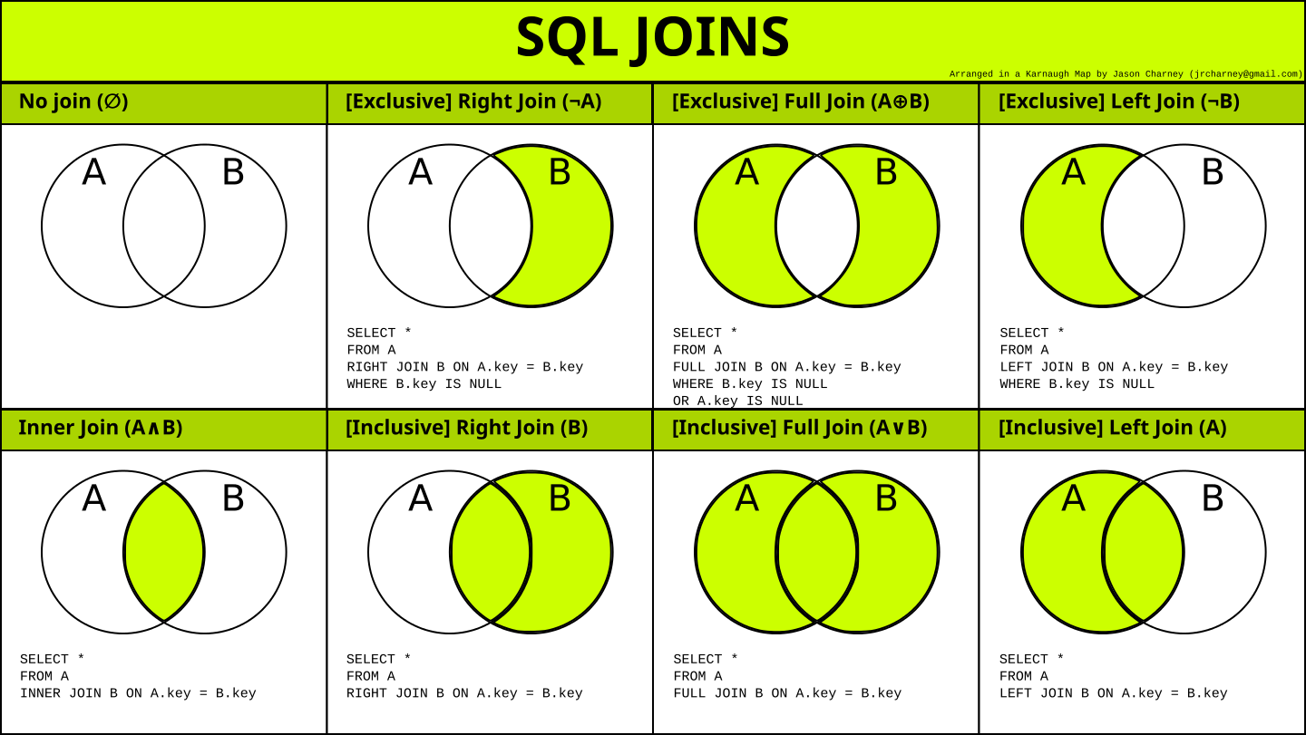

Slide 13
Data modeling
Tools :- phpMyAdmin, MySQL Workbench ETC.

Slide 14
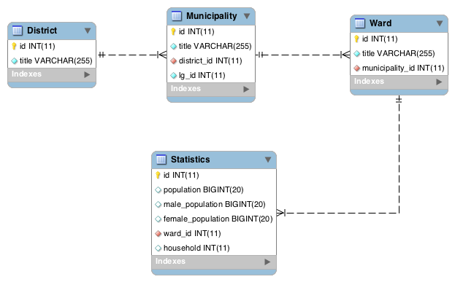
Schema

